Slide 1
Immediate care of the newborn
Reproductive module 2018
Dr. Ranmali Rodrigo (MBBS, DCH, MD, MRCPCH, IBCLC)
Lecturer Department of Paediatrics, University of Kelaniya
Consultant Neonatologist
Internationally Board Certified Lactation Consultant

Slide 2
There is a widely shared but mistaken idea that improvements in newborn health requires advanced technologies and highly trained staff
WHO manual on neonatal care for countries with limited resources
2003

Slide 3
Basic Newborn Interventions – At birth
Skilled care at birth
Antenatal steroids
Prophylactic antibiotics for PROM
Delayed cord clamping & cord care
Skin to skin contact
First breast feed within 1 hour of birth
Prevention of hypothermia
Effective bag and mask ventilation
Vitamin K prophylaxis
Identifying major congenital anomalies

Slide 4
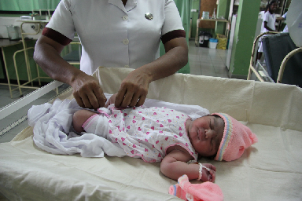
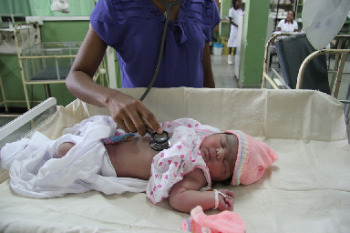
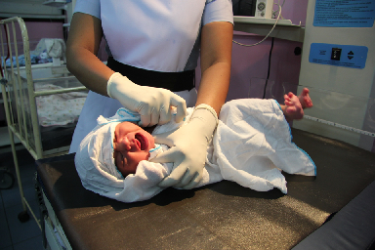
Skilled care at birth
In Sri Lanka >98% of births attended by skilled health care worker
This is a great achievement we need to take advantage of…
‘Basic newborn care can save lives’

Slide 5
Antenatal steroids
Prematurity: 10-12%
For mothers at risk of giving birth at <35weeks gestation
Complications of prematurity reduced – especially RDS
Practically:
  Dexamethasone 8mg IM every 12 hours ( 3 doses)
  Optimal benefit when delivery occurs 24 hours after completing therapy.
Notes:
Incidence of prematurity: 10-12%
Antenatal steroids are indicated For mothers at risk of giving birth at <35weeks gestation
Complications of prematurity and mortality reduced by 30-50% by giving antenatal steroids (ANS) to mother.
Recommended:
Betamethasone 12 mg IM every 24 hours (2 doses) OR
Dexamethasone 6 mg IM every 12 hours (4 doses)
Practically:
Dexamethasone 8mg IM every 12 hours ( 3 doses)
Optimal benefit when delivery occurs 24 hours -7 days after completing therapy.

Slide 6
Prophylactic antibiotics to mother
Antibiotics to the mother for prolonged rupture of membranes (>18hours)
  Prevents early onset sepsis in the newborn
  Drugs used: erythromycin / ampicillin /penicillin
  Monitor : maternal temperature, FBC, CRP, HR, HVS (high vaginal swabs)
Notes:
Prophylactic antibiotis sto the mother
Antibiotics to the mother for PROM (prolonged rupture of membranes)
Prevents early onset sepsis in the newborn
Drugs used
Oral Erythromycin or
IV ampicillin followed by oral erythromycin
Varies according to mother being in labour/not
History of GBS sepsis in a previous baby / vaginal swab with GBS – IV penicillin recommended during labour

Slide 7
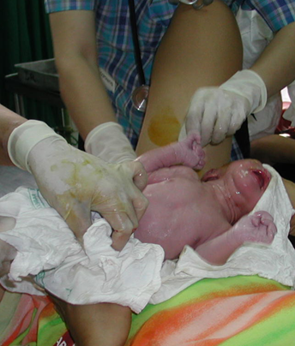
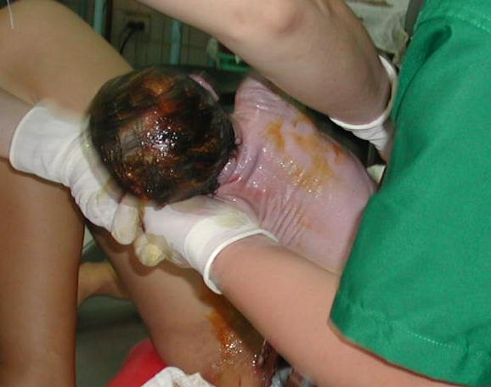
Ten steps at birth (ENCC)
Call out the time of birth
Dry baby with a warm clean towel or a piece of cloth; wipe eyes
Assess the baby’s breathing while drying
Delayed cord clamping (change gloves before clamping)

Slide 8
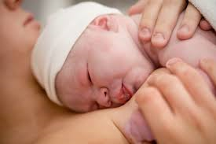
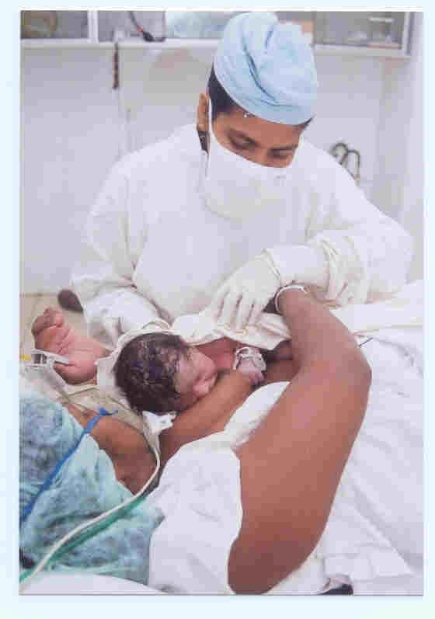
Ten steps at birth (ENCC)
5. Deliver baby on to mother’s abdomen after cord clamping
6. Cover mother and baby with warm cloth
7. Put a hat on the baby’s head
8. Baby remains between mother’s breasts skin to skin contact
9. Place an identity label on baby
10.Encourage first breastfeed within one hour of birth

Slide 9
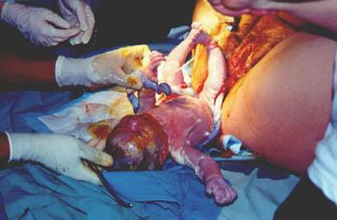
Delayed Cord Clamping
Delay in umbilical cord clamping
  for at least 1 minute for
  newborn infants not requiring resuscitation
  Hold at or below placental level (if possible)
  Advantageous for preterm more than term babies
Notes:
Delaying the clamping to 1 minute after birth allows the baby to receive additional blood. Preterm babies on whom delayed cord clamping was practiced have a more stable haemodynamic course in the first few days and require les blood transfusions; their rate of intraventricular haemorrhage is lower. In term babies the incidence of iron deficiency at 3-6 months is lower in those whose cords were clamped after a delay.
In view of these advantages it is recommended that the umbilical cord is clamped at least 1 minute after birth in babies who do not need resuscitation. If the baby is not breathing adequately resuscitation takes priority over delaying the clamping of the cord and baby should be taken for resuscitation as soon as possible.
During the one minute that the cord is not clamped the baby should be held at our below placenta level. So as the baby is born, baby should be taken onto a sterile warm towel and drying commenced while holding the baby at our below placenta level; at the same time the baby should be assessed to make sure resuscitation is not required. Once the one minute is up (by looking at a clock) the cor is clamped and the baby kept on the mother’ abdomen.

Slide 10
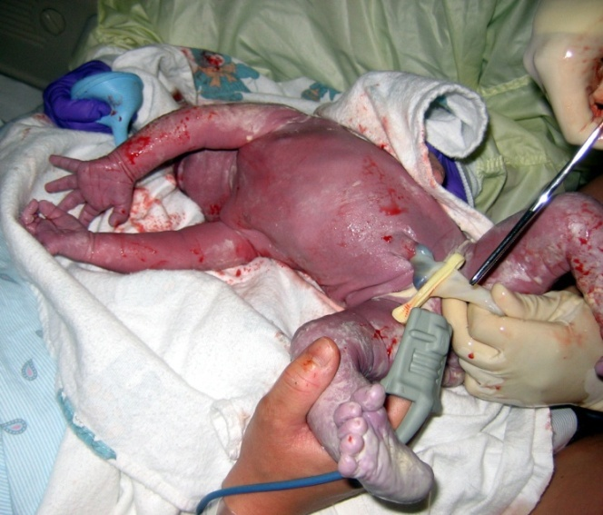
Cord Care
Clamp & cut cord 2 to 5cm from babies abdomen
Observe for oozing blood.
Put nothing on the stump
Leave stump uncovered and dry
Wash hands before and after cord care
Notes:
Clamp & cut cord 2 to 5cm from babies abdomen
Observe for oozing blood. If blood oozes, place a second tie between the skin and first tie.
Put nothing on the stump
Leave stump uncovered

Slide 11
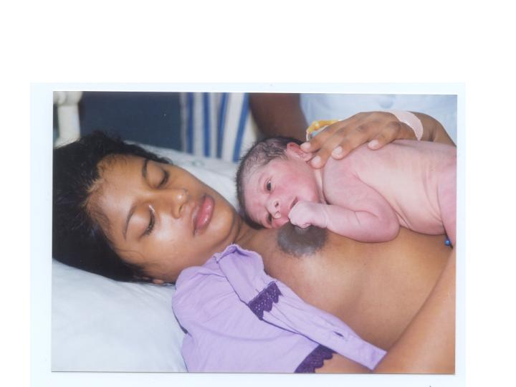
Immediate skin-to skin contact;
Naked baby between mother’s naked breasts,
Cover them both
Advantages:
Establish breastfeeding early
Prevent hypothermia
Bonding
Colonise with maternal flora
Prevent hypothermia
Notes:
Put naked baby between mother’s naked breasts,
cover them both (as long as immediate medical care is not needed by either).
Prevent hypothermia
Bonding
Colonise with maternal flora

Slide 12
Baby friendly hospital initiative - 2018
Step 4: Facilitate immediate and uninterrupted skin-to-skin contact and support mothers to initiate breastfeeding as soon as possible after birth.
1991 – first breastfeed within 30 minutes of birth
2009 – Help mothers initiate breastfeeding within one hour of birth

Slide 13
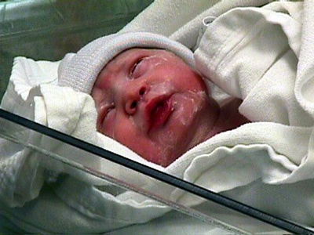
Skin care
Wipe amniotic fluid / meconium / blood at birth
Dry scalp and hair
Do not rub vigorously and wipe away vernix
Bathe only after 24 hours
Prevent hypothermia
Notes:
Wipe amniotic fluid / meconium blood at birth – skin creases, groin
Dry scalp and hair
Do not rub vigorously and wipe away vernix
Bathe after 24 hours

Slide 14
Eye care
No special treatment
Wipe with dry clean cloth
Wash
  any maternal blood / vernix
  with distilled water
  on sterile cotton wool
Further action only if sticky / eye is red

Slide 15
Nursing Care – after first feed
Baby with mother or under warmer
Check cord clamp
Check weight
Check & document temperature
Administer IM Vitamin K
Observe CTBH
    Clean thermometer
    Hold vertically in axilla for 3min
    Read and record
    Normal 36.5ºC-37.5º
Notes:
Get the baby under warmer
Check the cord clamp; dry cord care; no surgical spirit
Check the weight
Check & document temperature
No bathing for 24 hrs
Administer IM Vitamin K
Observe for CTBH

Slide 16
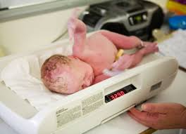
Weighing the baby
Digital scale
Prepare scale - clean cloth/paper, zero
Preparing and weighing the baby
    Remove all clothing
    Wait till the baby stops moving
    Weigh naked
    Read and record
Scale maintenance
Teaching Aids: ENC
Notes:
Digital scale (upto 3 decimal points)
Prepare the scale: cover the pan with a clean cloth/autoclaved paper; ensure the scale reads zero
Preparing and weighing the baby
Remove all clothing
Wait till the baby stops moving
Weigh naked
Read and record
Return the baby to the mother
Scale maintenance
Calibrate daily
Clean the scale pan between each weighing

Slide 17
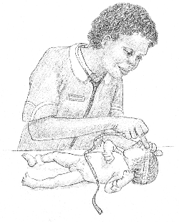

Other growth measurements
Head circumference
  Tape placement
  Use non-stretchable tape
Length
  Use infantometer
  Crown to heel
Notes:
Head circumference
Mid way between hairline & eyebrows anteriorly /occipital prominence posteriorly
Use non-stretchable tape
Length
Use infantometer
Crown to heel

Slide 18
Vitamin K administration
Routinely administered intramuscularly
    1ml syringe with 23G needle
To prevent haemorrhagic disease of newborn
Dose:
  1mg for term
  0.5mg for preterm

Slide 19
Neonatal Examination – At birth
Look for signs of major congenital anomalies
By medical officer / nursing officer / midwife
Dysmorphism
Excessive drooling
Cleft palate & hair lip
Eyes /ears /spine / limbs /scalp swellings
Anal/ urethral anomalies
By medical officer
Heart sounds on both sides (by MO)
Femoral pulse (by MO)
Notes:
Dysmorphic features
Excessive drooling of saliva (frothing)
To exclude TOF
Cleft palate & hair lip
Check for heart sounds on both sides
Femoral pulse
Check anus
Look for abnormal swelling
Abnormality of limbs & spine & urethra & anus
Eyes, ears,

Slide 20
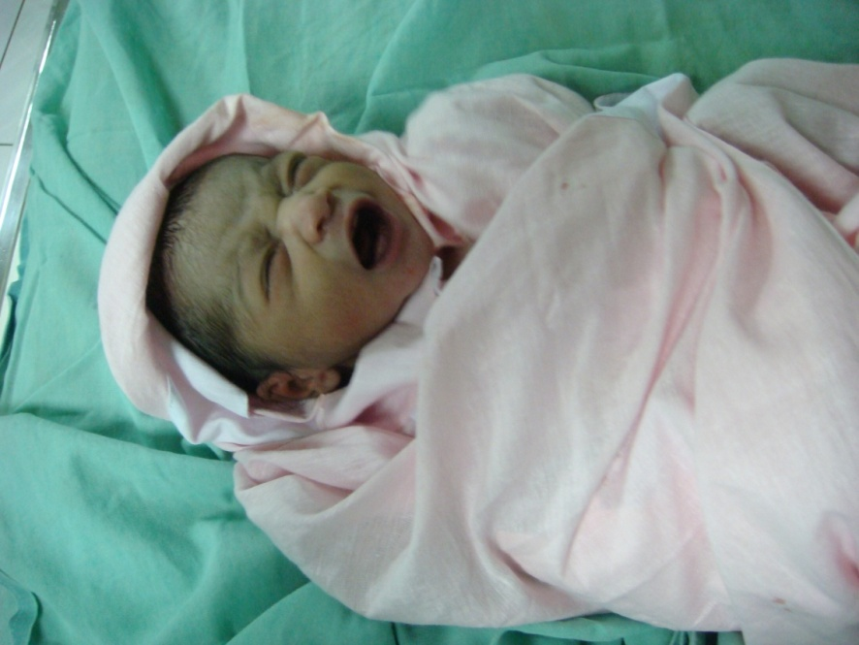
Before transfer to postnatal ward
Dress and wrap; cap, stocks
Transfer skin-to-skin contact
Check
  Quick CTBH assessment
  Vitamin K
Check & record baby’s temperature
Notes:
Dress and wrap in soft dry clean cloth, cover head with cap, stocks
Transfer skin-to-skin contact
Check
Quick examination
Vitamin K
Temperature and record
Check baby’s temperature

Slide 21
